Slide 1
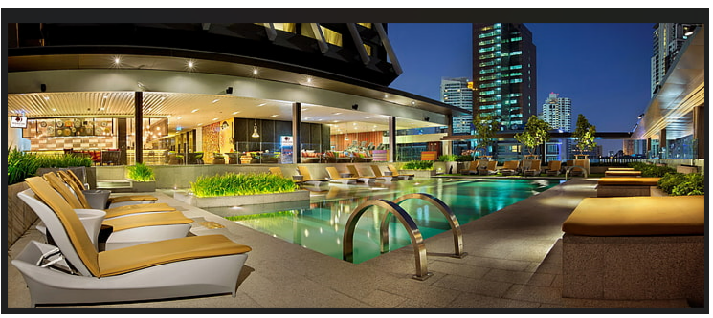
Capstone Project - 1 EDA On Hotel Booking Analysis By Manas Nayan Mukherjee and Kunal R Kodarlikar (Cohort Boston)

Slide 2

Problem Statement:
For this project we will be analyzing Hotel Booking data. This data set contains booking information for a city hotel and a resort hotel, and includes information such as when the booking was made, length of stay, the number of adults, children or babies and the number of available parking spaces.
The main objective behind this project is to explore and analyze data to discover important factors that govern the booking and give insights to hotel management, which can perform various campaigns to boost the business and performance.
Hotel industry is a very volatile industry and the booking depends on below factors and many more.

Slide 3

Work flow segregation :
So we have divided our work flow into following 3 Steps:
EDA will be divided into following 3 analysis:
Univariate Analysis: Univariate analysis is the simplest of the three analysis where the data you are analyzing is only having one variable.
Bivariate analysis: In Bivariate analysis we will compare two variables to study their relationships.
Multivariate analysis: Multivariate analysis is similar to Bivariate analysis here we will compare more than two variables.
Data collection
and
Understanding
Data Cleaning
and
Manipulation
Exploratory
Data
Analysis(EDA)

Slide 4
After collecting data it’s very important to understand it. We have hotel booking in which we have 119391 rows and 32 colunms. Let’s understand these 32 colouns.
Description of data:
hotel: Resort Hotel or City hotel.
is_canceled: Value indicating if the booking was cancelled (1) or not (0).
lead time: Number of days that elapsed between the entering date of the booking and the arrival date.
arrival_date_year: Year of arrival date.
arrival_date_month: Month of arrival date.
arrival_date_day_of_month: Day of arrival date.
stays_in_weekend_nights: Number of weekend nights.
stays_in_week_nights: Number of week nights.
adults: Number of adults.
children: Number of children.
babies: Number of babies.
meal : Type of meal booked.
country : Country of origin.

Slide 5
Market_segment : Market segment designation (TA/TO).
Distribution_channel : Booking distribution channel (TA/TO).
Is_repeated_guest : is a repeat guest (1) or not (0).
Previous_cancellations : Number of previous bookings which were cancelled by the customer prior the current booking.
Previous_booking_not_cancelled : Number of previous bookings not cancelled by the customer prior to the current booking.
Reserved_room_type : Code of room type resereved.
Assigned_room_type : Code for the type of room assigned to the booking.
Booking_changes : Number of changes made to the booking from the moment the booking was entered on the PMS (Hotel property management systems) untill the moment of check-in or cancellation.
Deposit_type : No deposit, Non refund, Refundable.
Agent: ID of the travel agency that made the booking.
Company: ID of the company/ entity that made the booking.
Days_in_waiting_list : Number of days the booking was in the waiting list before it was confirmed to the customer.
Customer_type : type of customer. Contract, Group, Transient, Transient party.
Adr : Average daily rate as defined by dividing the sum of all lodging transactions by the total number of staying nights.
Required_car_parking_spaces : Number of car parking spaces required by the customer.
total_of_special_request : Number of special requests made by the customer (e.g double bed or high floor).
Reservation_status: Reservation last status.

Slide 6

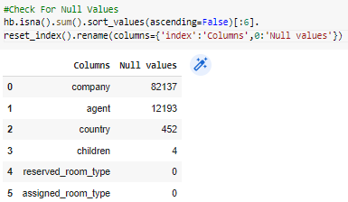


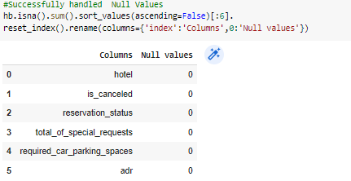
There are 4 columns company, agent, country and children with missing values.
#checking for Null values

Slide 7
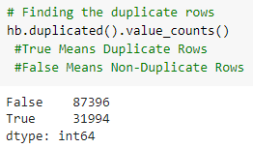
Handling Duplicates: data had 31994 duplicate values. So we dropped it from the data

Slide 8
Feature Engineering:
We created 2 new columns
1) ‘Total_People’ = from the Chidren, adults, babies.
hb['total_people'] = hb['adults'] + hb['babies’] + hb['children']
2) ‘Total_stay’ = From weekend nights and weekdays night
hb['total_stay'] = hb['stays_in_weekend_nights’] + hb['stays_in_week_nights']

Slide 9
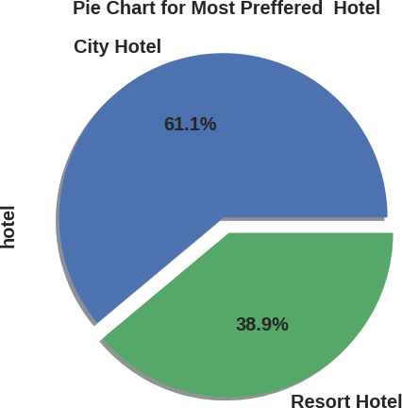
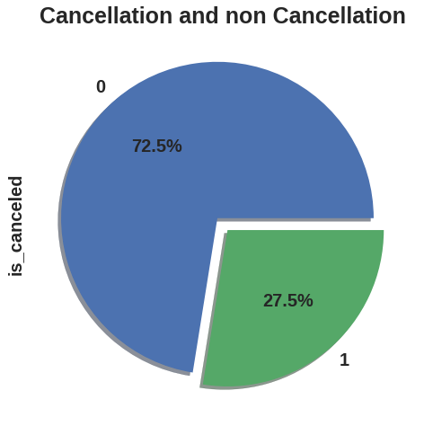
Conclusions:
City hotels are the most preferred hotel type by the guests. We can say City hotel is the busiest hotel.
27.5 % bookings were got cancelled out of all the bookings

Slide 10
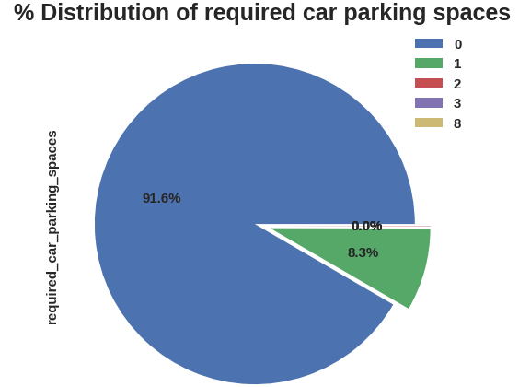
Observation:
91.6% guests did not required the parking space. Only 8.3% guests required 1 parking space

Slide 11
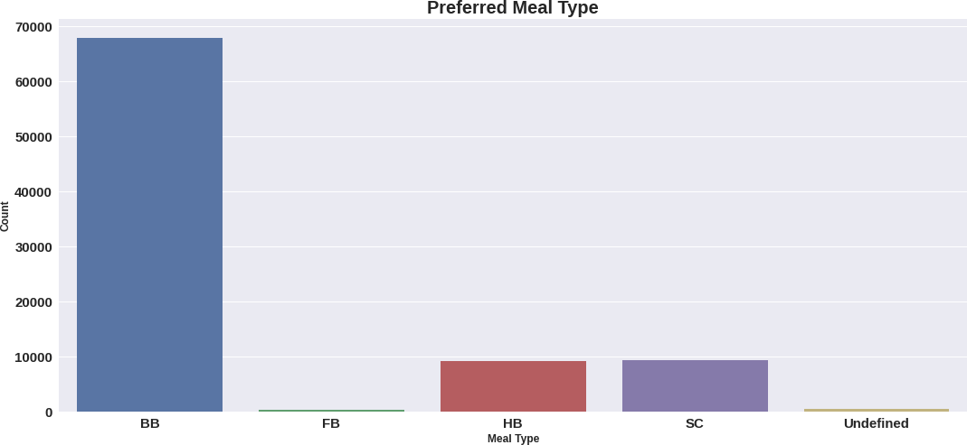
Observation:
BB( Bed & Breakfast) is the most preferred type of meal by the guests.
Full Board i.e. FB is least preferred.
HB (Half Board) and SC(Self Catering) are equally preferred.

Slide 12
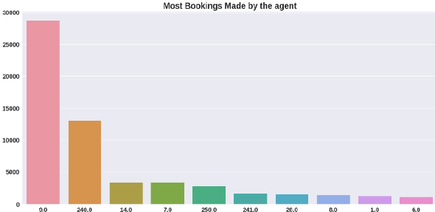
Conclusions:
Agent Id Number – 9.0 made the highest bookings which is more than 28725.

Slide 13
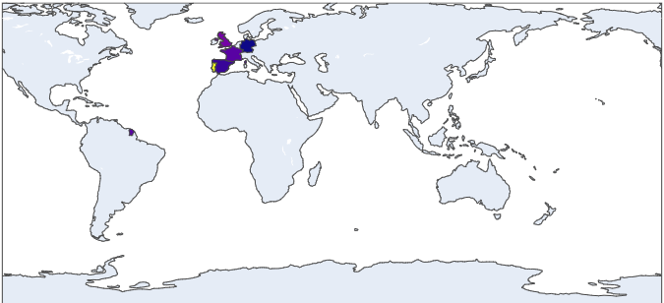

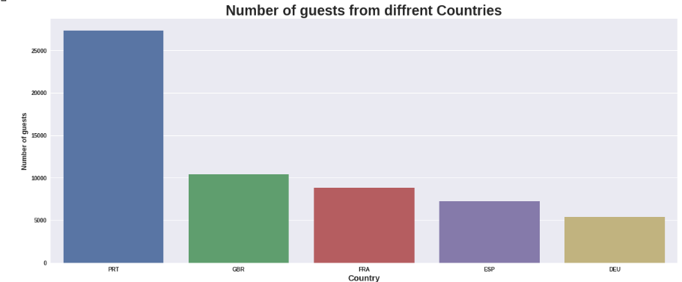
Conclusions:
Maximum number of guests were from Portugal. i.e. more than 24500+ guests.
After Portugal, GBR(Great Brittan),France and Spain are the countries from where most of the guests came.

Slide 14
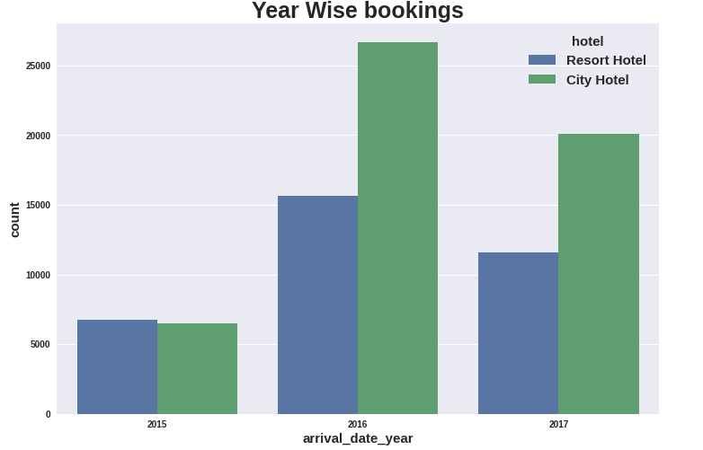
Conclusions:
Most of the bookings for City hotels and Resort hotel were happened in 2016.
As we can see Most of the bookings were for City hotels.
Least number of bookings for City hotels and Resort hotel were happened in 2015.
As we can see Least of the bookings were for Resort hotels.

Slide 15
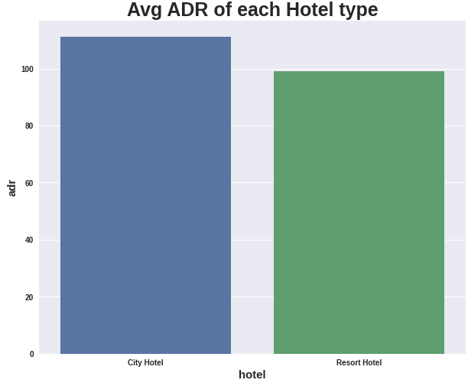
Conclusions:
City hotel has the highest ADR. That means city hotels are generating more revenues than the resort hotels.
More the ADR more is the revenue.

Slide 16
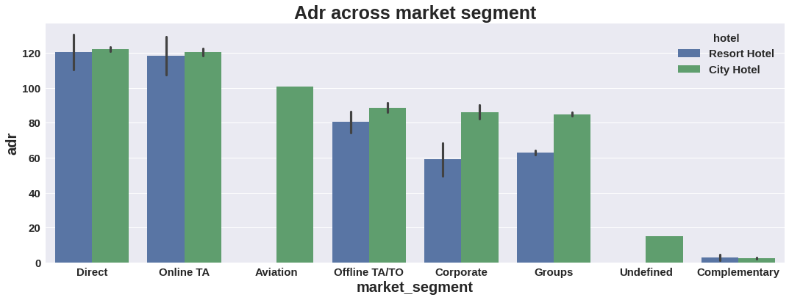
Conclusions:
Market Segment:
Here “Direct” and ‘Online Travel Agency’ has high adr for both hotel types. Aviation segment needs to increase Resort hotel bookings.

Slide 17
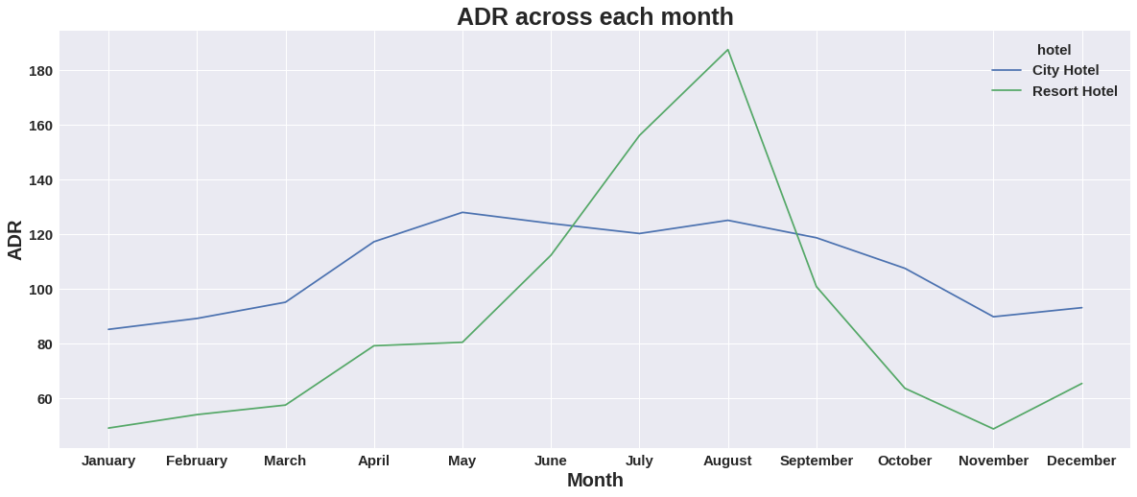
Conclusions:
Resort hotels had the highest adr in June ,July and August than the City hotels. But in other months adr of Resort hotel was less than the City hotels.
Thus we can say that, the January, February, March, April ,November and December are the good months for customers to get good adr

Slide 18
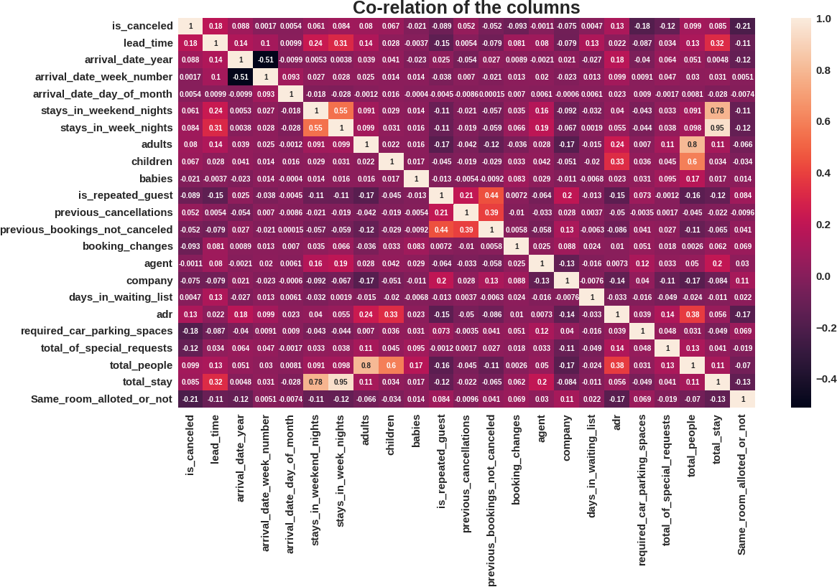
Conclusions:
is canceled and same_room_alloted_or_not are negatively correlated. Not getting the same room as per reserved room is not the reason for booking cancellations.
lead-time and total stay is positively correlated means more is the stay of customer more will be the lead time.
ADR and total people are highly correlated. That means more the people more will be adr.High adr means high revenue

Slide 19
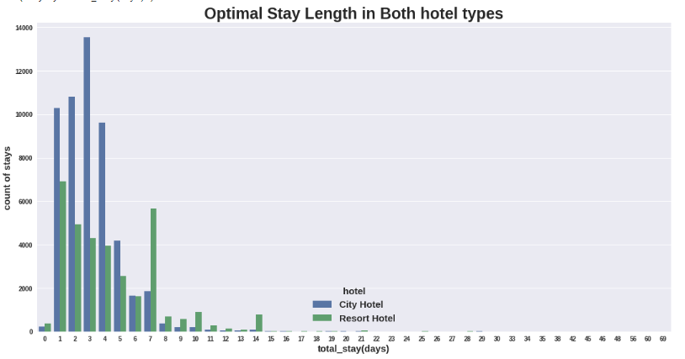
Conclusions:
Optimal stay in both the type hotel is less than 7 days.

Slide 20


